Slide 1
Figure 1. Effect of induration temperature on CCS of pellet

Slide 2
Figure 2. Effect of induration temperature on apparent porosity of pellet

Slide 3
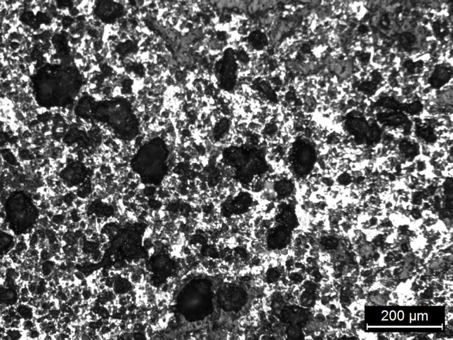
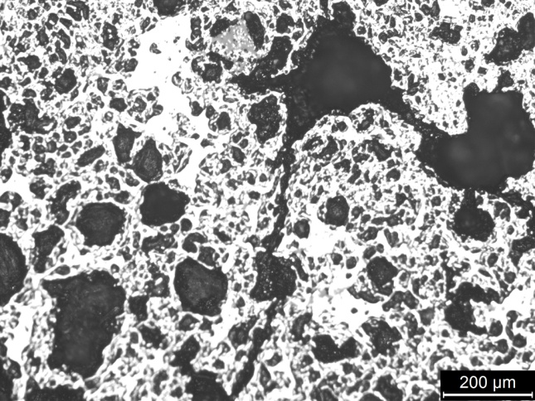
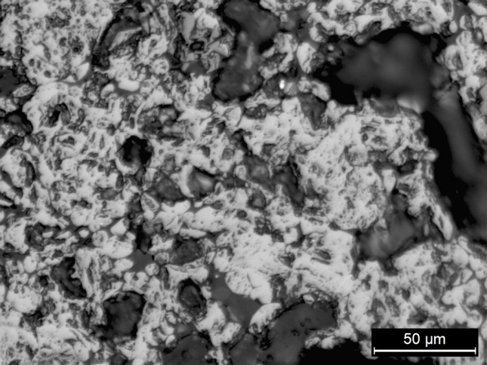
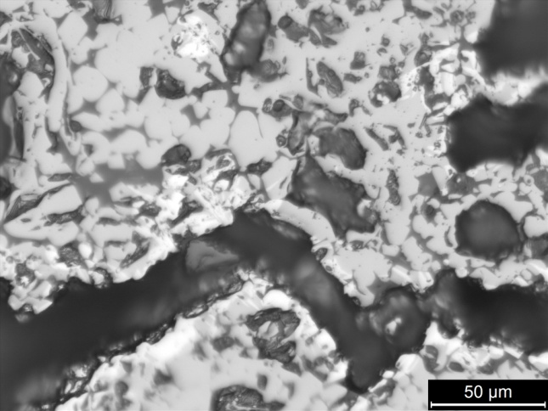
(a) 1275 °C, 100x
(b) 1325 °C, 100x
(c) 1275 °C, 500x
(d) 1325 °C, 500x
Figure 3. Optical microstructure of Indurated pellet at different temperature

Slide 4
Figure 4. Effect of induration temperature on RI of pellet

Slide 5
Figure 5. Effect of pellet size on RI of pellet

Slide 6
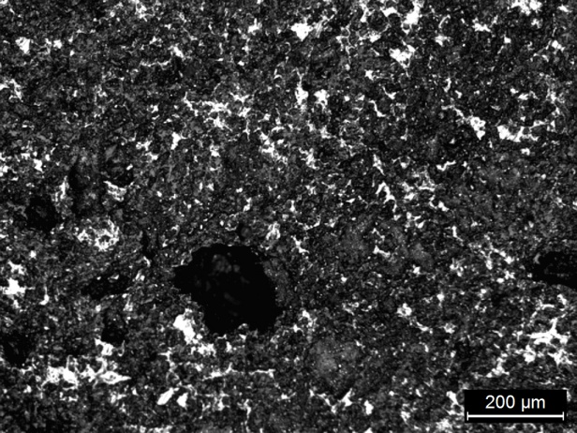
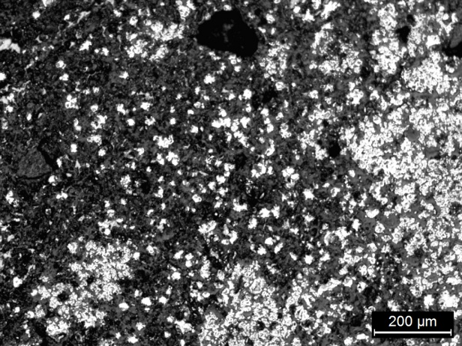
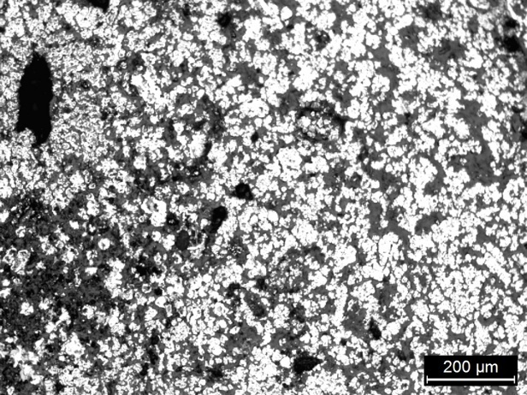
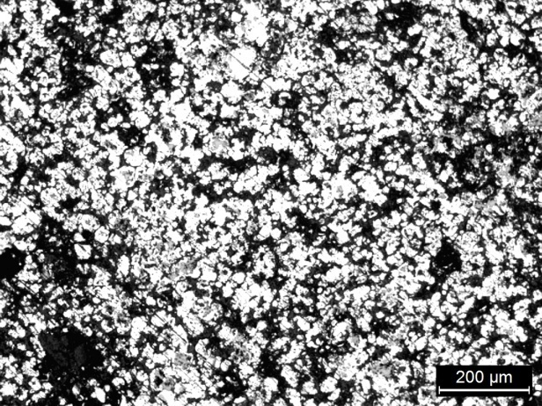

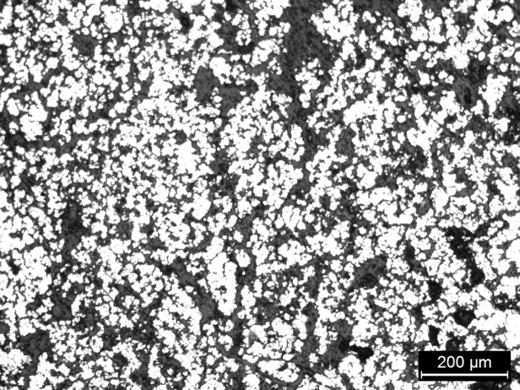
(a₁) Centre
(a₂) Intermediate
(a₃) Periphery
(b₁) Centre
(b₂) Intermediate
(b₃) Periphery
Figure 6. Microstructure of reduced pellets varying diameter
(a₁, a₂ and a₃)16 mm pellet, (b₁, b₂ and b₃) 9 mm pellet

Slide 7
Figure 7. Effect of pellet size on swelling index of pellet

Slide 8
Figure 8. Effect of fineness of limestone powder on CCS of pellet

Slide 9
Figure 9. Effect of fineness of limestone powder on apparent porosity and RI of pellet

Slide 10
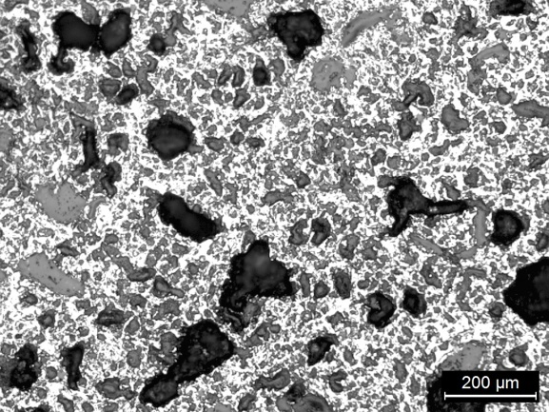
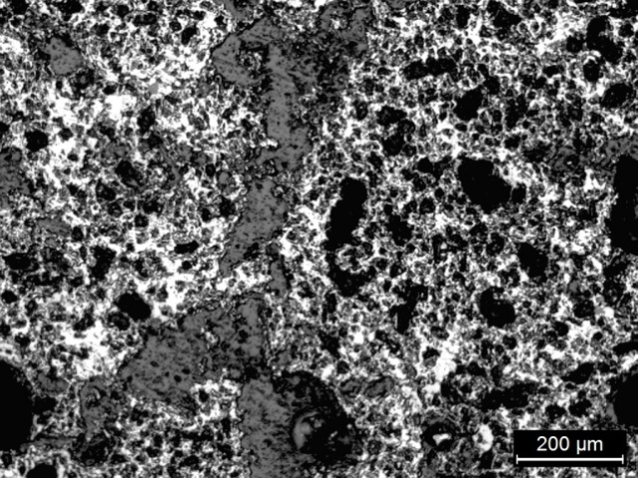
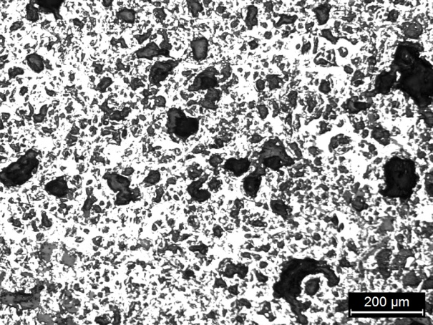
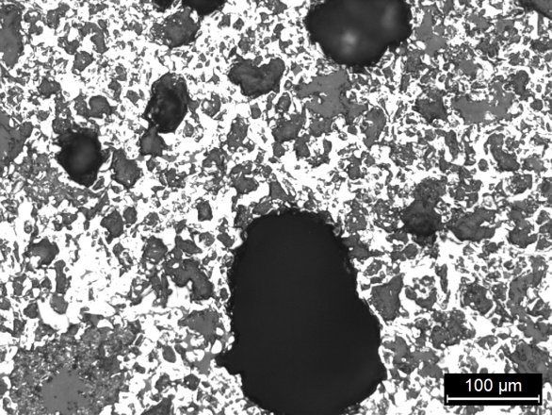
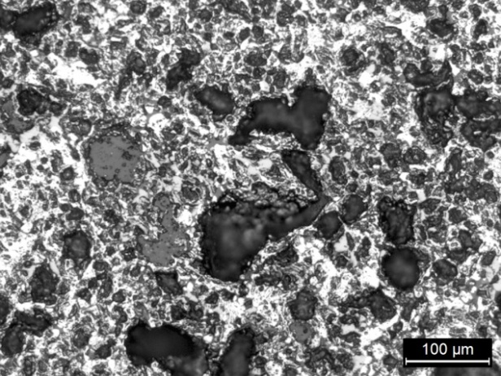
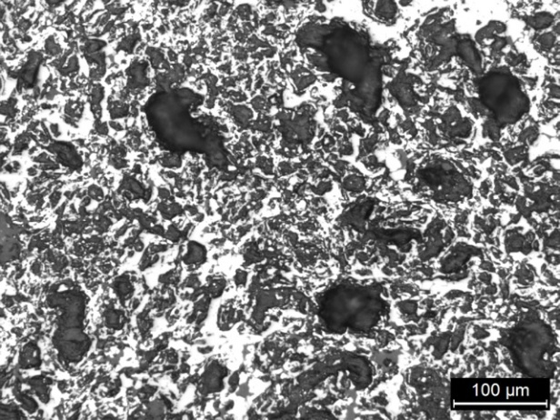
(a) - 72 mesh L.S, 100x
(b) - 200 mesh L.S, 100x
(c)- 350 mesh L.S, 100x
(d) - 72 mesh L.S, 200x
(e) - 200 mesh L.S , 200x
(f) - 350 mesh L.S, 200x
Figure 10 . Micro structure of pellet with varying fineness of limestone (LS) powder

Slide 11
Figure 11. Effect of fineness of anthracite coal powder on CCS of pellet

Slide 12
Figure 12. Effect of fineness of anthracite coal powder on apparent porosity and RI of pellet

Slide 13
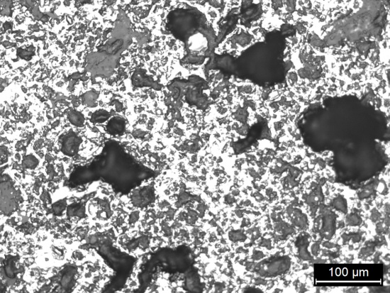
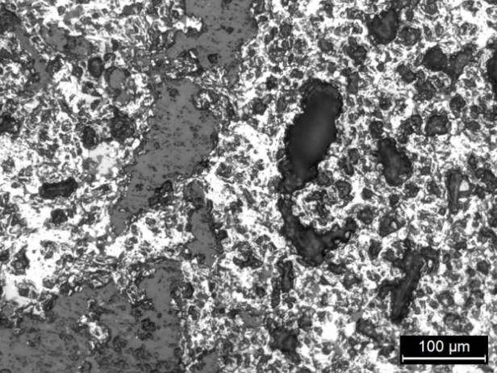
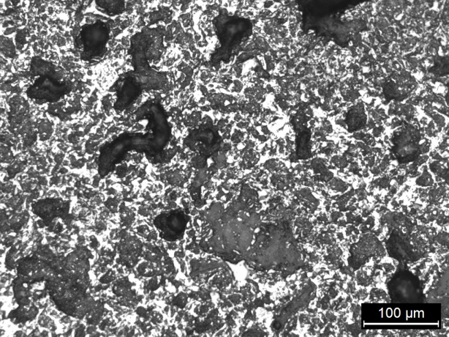
(a) - 72 mesh L.S, 200x
(b) - 100 mesh L.S, 200x
(c)- 200 mesh L.S, 200x
Figure 13 . Micro structure of pellet with varying fineness of anthracite coal powder

